Slide 1
English 2 July 14
Max Keenan

Slide 2
Attendance
What’s the most important quality a friend should have?

Slide 3
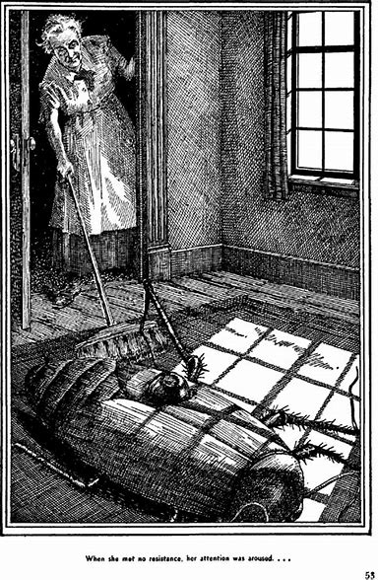
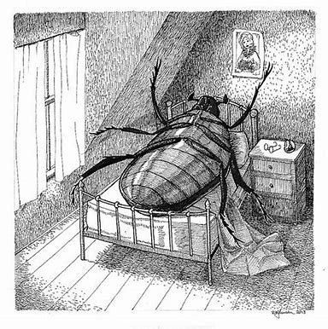
The Metamorphosis

Slide 4
Journal 3
What makes people happy in life? Is it a good relationship, doing what you love, or having many things? Explain your answer with details and examples.

